Slide 1


Manufacturing Downtime Analysis Project Digital Egypt Pioneers Initiative - Google Data Analyst Specialist Track
Team Members:
Marwa Ibrahim Olfat Rady Mahmoud Farag Abdulrahman Hesham

Slide 2

Summary
Overview:
In a soda bottling production line, various inefficiencies were observed over five days, leading to decreased efficiency and output.
The dataset includes information on:
✅ Operators
✅ Products
✅ Start and End times
✅ Downtime factors
Objective:
We analyzed this data to uncover key insights that can help identify inefficiencies and improve productivity.

Slide 3
Challenges
We encountered two main challenges while analyzing the data:
1️⃣ Calculating Manufacturing Duration:
The dataset lacked an explicit column for manufacturing duration.
We had to compute it using SQL & Python by calculating the difference between batch start and end times.
2️⃣ Unpivoting Line Downtime Factors:
Downtime factors were listed as separate columns instead of a structured format.
We used SQL & Python to transform the data into a normalized structure for better analysis.

Slide 4

Solutions
1️⃣ For Manufacturing Duration Calculation:
We wrote SQL queries and Python scripts to compute the exact production duration for each batch.
This helped in measuring efficiency and identifying the time spent per batch.
2️⃣ For Unpivoting Downtime Data:
We used SQL `UNPIVOT` and Python’s `melt()` function to transform the dataset.
This restructuring allowed for a deeper analysis of downtime factors.

Slide 5
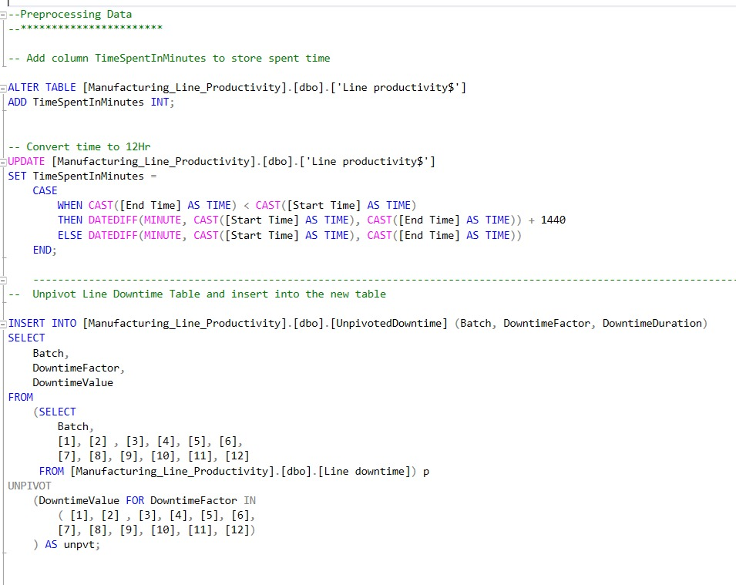
Using SQL

Slide 6
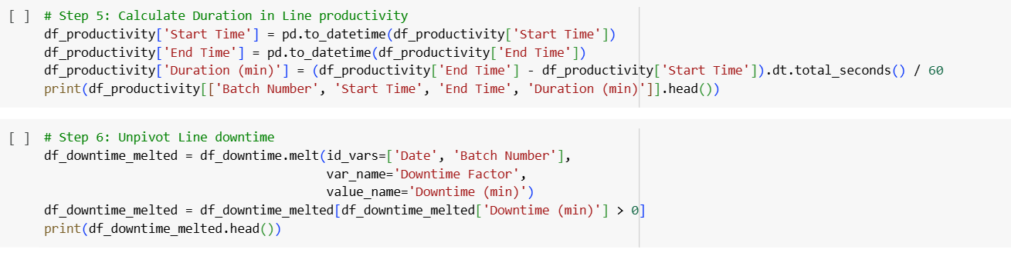
Using Python

Slide 7

Outcomes
We created two Tableau dashboards to visualize key insights.
1. Operator Analysis Dashboard:
Displays Total Production Time, Total Downtime, and Overall Efficiency.
Helps track batch-level productivity and identify trends in performance.
Key Insight: Operator errors contributed significantly to downtime. Some operators showed repeated delays, highlighting the need for targeted training and workflow improvements.

Slide 8
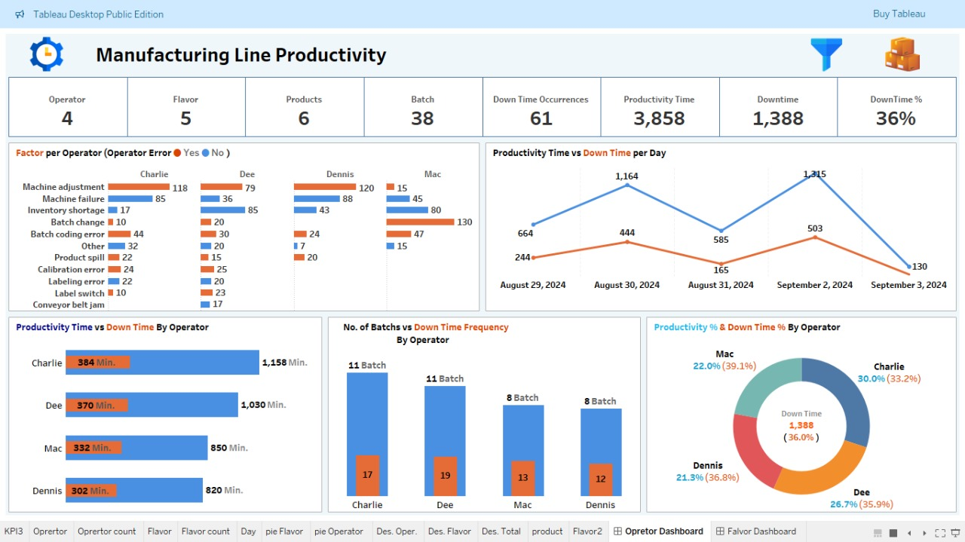

Slide 9
Outcomes
We created two Tableau dashboards to visualize key insights.
2. Flavor Analysis Dashboard:
Identifies the impact of different flavors on production efficiency.
Highlights which products and operators are most affected by downtime.
Key Insight: Certain flavors had consistently higher downtime due to frequent machine recalibrations and ingredient inconsistencies. Optimizing these factors can enhance overall production efficiency.

Slide 10
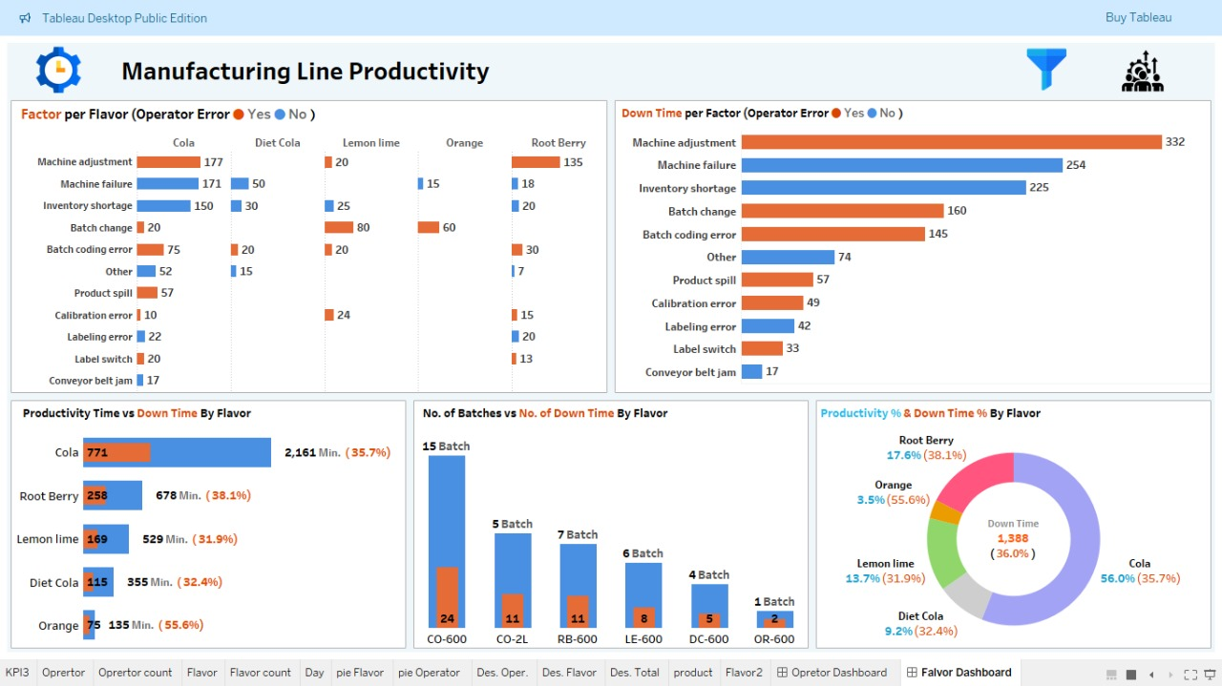

Slide 11
Data-Driven Recommendations for Efficiency Improvement
1. Training for Operators Analysis: Data shows that human errors like Machine adjustment , batch changes and coding contribute to downtime. Suggestion: Implement regular training programs for operators to enhance skills and reduce errors. 2. Improving Machinery Efficiency Analysis: Frequent breakdowns such as machine failures increase downtime. Suggestion: Conduct regular maintenance and enhance inspection processes to minimize unexpected failures. 3. Ensuring Raw Material Availability Analysis: Shortages of raw materials have directly contributed to production delays. Suggestion: Improve inventory management to ensure adequate stock levels of raw materials, preventing interruptions in production.

Slide 12
Data-Driven Recommendations for Efficiency Improvement
4. Discontinuing Ineffective Products Analysis: Some flavors, such as CO-2L, require longer production times without generating good returns. Suggestion: Conduct feasibility studies to consider discontinuing unprofitable or low-efficiency products. 5. Target Audience Senior Management: To understand the importance of training, equipment improvement, and ensuring raw material availability. 6. Production Team: To enhance performance and reduce downtime. 7. Maintenance Team: To focus efforts on more effective machinery maintenance.
You can find all the relevant resources and documentation related to this project on our GitHub page: https://github.com/abdulrahmanhesham/ManufacturingDowntime.

